Slide 1
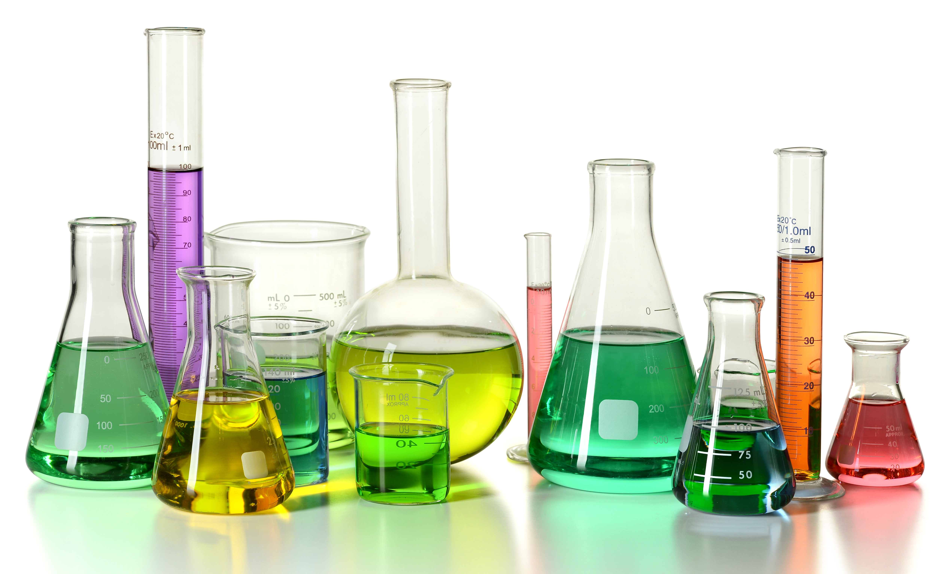
Scientific Method
Task Cards
Directions: Complete the question or task found on each of the cards. Record your answers on the answer sheet or on your notebook paper as directed by your teacher.
© Amy Brown Science

Slide 2

1
Scientific Method
All scientific investigations begin with:
(a) Forming a hypothesis.
(b) Conducting an experiment.
(c) Asking a question or observing a problem.
(d) Forming a conclusion.
Answer: c

Slide 3
2
Scientific Method
The steps of the scientific method are listed
below, but they are not in the correct order.
What is the correct order of the steps in the scientific method?
(a) Conduct the experiment.
(b) Form a hypothesis.
(c) Form a conclusion.
(d) Report your results.
(e) Make an observation.
(f) Analyze the data.
Answer: e, b, a, f, c, d

Slide 4
3
Scientific Method
Often a scientist collects data that is numerical. For example, the scientist might measure the length of growing root tips, or determine the rate of a particular reaction. What is the name of this type of data?
Answer: Quantitative data

Slide 5
4
Scientific Method
Sometimes a scientist collects data that is descriptive in nature. For example, “When X and Y are mixed together, they turn a blue color.” What name is given to the type of data that is descriptive rather than numerical?
Answer: Qualitative data

Slide 6
5
Scientific Method
The data collected during an experiment are of little use unless they are organized. In what ways might data be logically organized?
Answer: Graphs, charts, tables, or maps.

Slide 7
6
Scientific Method
Forming a hypothesis is an important step in the scientific method. What is the purpose of the hypothesis in an experiment?
Answer: The hypothesis is a possible answer to the question or problem. It is a “testable” statement that is either supported or unsupported by the data collected in the experiment.

Slide 8
7
Scientific Method
A student is conducting an experiment to test how temperature might affect the action of a particular enzyme. How might a hypothesis for this experiment be stated?
Answer: Student answers will vary.
One possibility might include: “I predict that the rate of the enzymatic reaction will be highest at a temperature of 40 ˚C.”
(This is a statement that can easily be tested.)

Slide 9
8
Scientific Method
True or False?
Although a hypothesis may be supported by evidence, it can never be proven true beyond all doubt since new data might indicate that the hypothesis does not hold true in all instances.
Answer: True

Slide 10
9
Scientific Method
How is it determined if a hypothesis is correct or incorrect?
Answer: An experiment is carried out to test the hypothesis.

Slide 11
10
Scientific Method
Define the term “controlled experiment.”
Answer: In a controlled experiment only one variable is changed at a time. All other variables should be unchanged or “controlled.”

Slide 12
11
Scientific Method
Every experiment should consist of two groups. Name these two groups.
Answer: Experimental group and control group.

Slide 13
12
Scientific Method
In an experiment, what is the purpose of the experimental group?
Answer: It shows the effect of the one variable that is being tested.

Slide 14
13
Scientific Method
In an experiment, what is the purpose of the control group?
Answer: The control group is the same as the experimental group except that the factor being tested is omitted. The control group shows what will happen in the absence of the experimental factor.

Slide 15
14
Scientific Method
There are two variables in every experiment. Name the two variables.
Answer: Independent variable and dependent variable.

Slide 16
15
Scientific Method
Which one of the following steps would occur last?
(a) Analyze the data from the experiment.
(b) Organize the data into charts, tables, and graphs.
(c) Publish the results.
(d) Form a conclusion based on the data.
(e) Repeat the experiment to determine if the data from the first experiment is reliable.
Answer: c

Slide 17
16
Scientific Method
Give an example of an experiment that uses quantitative data.
Answer: There are many, many possible answers.
Possibilities include:
Determining the mass, volume, and density of an object.
Measuring the mass of melons fertilized with different fertilizers.
Calculating the rate of a reaction.
Measuring the amount of oxygen consumed during cellular respiration.
Determining the change in mass of potatoes placed in various solutions.

Slide 18
17
Scientific Method
Give an example of an experiment that uses qualitative data.
Answer: There are many, many possible answers.
Possibilities include:
Describing the behavior of pill bugs placed in a maze.
Observing and describing the parts of a cell being viewed under a microscope.
Recording color changes during a chemical reaction.

Slide 19
18
Scientific Method
The variable that is deliberately changed in an experiment is called the:
(a) Dependent variable
(b) Controlled variable
(c) Hypothetical variable
(d) Independent variable
Answer: d

Slide 20
19
Scientific Method
The variable that is the result of the independent variable is called the:
(a) Dependent variable
(b) Controlled variable
(c) Hypothetical variable
(d) Unidentifiable variable
Answer: a

Slide 21
20
Scientific Method
Catalase is an enzyme that speeds up the breakdown of
hydrogen peroxide in cells. During this reaction oxygen is given off. A scientist designs an experiment to determine how much oxygen is given off when varying concentrations of catalase are used.
(a) What is the independent variable?
(b) What is the dependent variable?
Answer: The independent variable is the concentration of the catalase.
The dependent variable is the amount of oxygen given off as a result of the reaction.

Slide 22
21
Scientific Method
A student wanted to know which type of sugar would
yield the greatest amount of energy for the cell when metabolized during cellular respiration by the mitochondria. The student mixed yeasts in three different sugar solutions: maltose, glucose, and sucrose. The three sets of yeasts were monitored to determine which sugar type yielded the most energy. Write a hypothesis for this experiment.
Answer: Student answers will vary. One possibility: “I predict that sucrose will provide the highest rate of cellular respiration.” Note: The hypothesis must be a testable statement. The hypothesis may or may not be supported by the data.

Slide 23
22
Scientific Method
A student wanted to know which type of sugar would
yield the greatest amount of energy for the cell when metabolized during cellular respiration by the mitochondria. The student mixed yeasts in three different sugar solutions: maltose, glucose, and sucrose. The three sets of yeasts were monitored to determine which sugar type yielded the most energy. What is the purpose of the yeasts?
Answer: The yeasts are the organisms carrying out cellular respiration.

Slide 24
23
Scientific Method
A student wanted to know which type of sugar would
yield the greatest amount of energy for the cell when metabolized during cellular respiration by the mitochondria. The student mixed yeasts in three different sugar solutions: maltose, glucose, and sucrose. The three sets of yeasts were monitored to determine which sugar type yielded the most energy. Describe a possible control group for this experiment.
Answer: The control could be:
• Sugar solutions to which no yeasts are added.
• Adding yeasts to a water solution in which no sugars have been added.

Slide 25
24
Scientific Method
A student wanted to know which type of sugar would
yield the greatest amount of energy for the cell when metabolized during cellular respiration by the mitochondria. The student mixed yeasts in three different sugar solutions: maltose, glucose, and sucrose. The three sets of yeasts were monitored to determine which sugar type yielded the most energy. What is the independent variable in this experiment?
Answer: The independent variable is the type of sugar given to the yeasts.

Slide 26
25
Scientific Method
A student wanted to know which type of sugar would
yield the greatest amount of energy for the cell when metabolized during cellular respiration by the mitochondria. The student mixed yeasts in three different sugar solutions: maltose, glucose, and sucrose. The three sets of yeasts were monitored to determine which sugar type yielded the most energy. What is the dependent variable in this experiment?
Answer: The dependent variable is the amount of energy obtained from a particular sugar during cellular respiration.

Slide 27
26
Scientific Method
A properly designed experiment changes only one variable at a time.
A student wanted to know which type of sugar would yield the greatest amount of energy for the cell when metabolized during cellular respiration by mitochondria. The student mixed yeasts in three different sugar solutions: maltose, glucose, and sucrose. The three sets of yeasts were monitored to determine which sugar type yielded the most energy. List three factors that the student must keep constant during the experiment.
Possible answers include:
• The amount of sugar in each solution must be constant.
• The amount of water in each solution must be constant.
• Each beaker should receive the same amount of yeast.
• All beakers should be kept at the same temperature.
• All beakers should be exposed to the same light levels.

Slide 28
27
Scientific Method
A student wants to test the effect of different amounts of caffeine on the heart rate of Daphnia, a small crustacean. Describe the experimental groups in this experiment.
Answer: The experimental groups would consist of organisms that are given varying amounts of caffeine.

Slide 29
28
Scientific Method
A student wants to test the effect of different amounts of caffeine on the heart rate of Daphnia, a small crustacean. Describe the control group in this experiment.
Answer: The control group would consist of Daphnia that are exposed to all of the same conditions as the experimental groups, but they would receive no caffeine.

Slide 30
29
Scientific Method
A student wants to test the effect of different amounts of caffeine on the heart rate of Daphnia, a small crustacean. What is the independent variable?
Answer: The independent variable is the quantity of caffeine given to Daphnia.

Slide 31
30
Scientific Method
A student wants to test the effect of different amounts of caffeine on the heart rate of Daphnia, a small crustacean. What is the dependent variable?
Answer: The dependent variable is the recorded heart rate of Daphnia.

Slide 32
31
Scientific Method
Consider an experiment designed to determine glucose production during photosynthesis when leaves are exposed to different wavelengths of light.
(a) What is the independent variable?
(b) What is the dependent variable?
Answer: The independent variable is the different wavelengths of light.
The dependent variable is the amount of glucose produced at each wavelength of light.

Slide 33
32
Scientific Method
Why must an experiment be repeated many times?
Answer: Experiments are repeated to see if the same results are obtained each time. This gives validity to the test results.

Slide 34
33
Scientific Method
Why is it necessary that only one variable be changed in an experiment, and that all other variables remain constant?
Answer: If more than one variable is changed at a time, it cannot be determined which variable is responsible for the observed results.

Slide 35
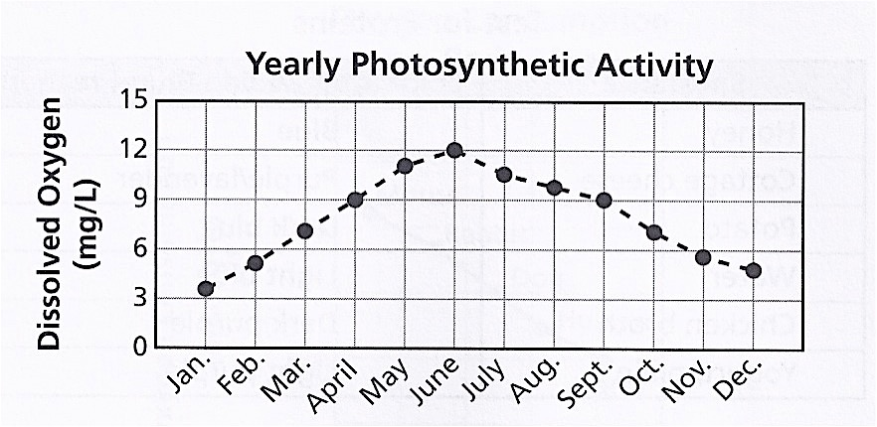
34
Scientific Method
Examine the data shown in the graph below.
What conclusion can be reached by the data shown on the graph?
Answer: The rate of photosynthesis is greatest during the months of May, June, and July. The rate of photosynthesis is significantly less during the winter months.

Slide 36
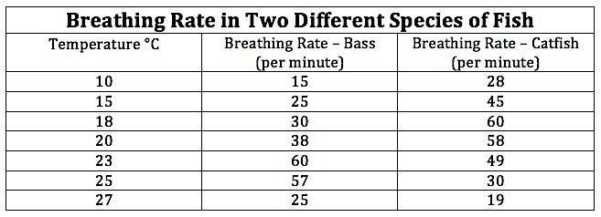
35
Scientific Method
Study the information in the table.
(a) What is the independent variable?
(b) What is the dependent variable?
Answer:
(a) The temperature of the water.
(b) The breathing rate of the fish.

Slide 37
36
Scientific Method
Study the information in the table.
What conclusion can be reached from this data?
Answer: Each species of fish has an optimum temperature that provides for the best breathing rate. The breathing rate of fish increases leading up to their optimum temperature and decreases at temperatures higher than their optimum temperature.

Slide 38
37
Scientific Method
Study the information in the table.
(a) At what temperature will the breathing rate of the bass be the highest?
(b) At 20 ˚C, how does the breathing rate of the bass compare to the breathing rate of the catfish?
Answer:
(a) 23 ˚C
(b) At 20 ˚C, the breathing rate of the catfish is much higher than the breathing rate of the bass.

Slide 39
38
Scientific Method
An experiment is carried out to determine if the boiling point of distilled water is affected by the addition of different types of solutes. Describe a control group for this experiment.
Answer: The boiling point of water is determined without the addition of any type of solute.

Slide 40
39
Scientific Method
A scientist is designing an experiment to see how temperature changes affect the volumes of three different gases. Write a hypothesis for this experiment.
Answer: Student answers will vary. The hypothesis should be a testable statement using the variables given in the experiment. For example: I predict that the volume of each gas will increase as the temperature increases.

Slide 41
40
Scientific Method
A scientist is designing an experiment to see how temperature changes affect the volumes of three different gases. What is the independent variable?
Answer: The independent variable is the change in temperatures at which each gas will be measured.

Slide 42
41
Scientific Method
A scientist is designing an experiment to see how temperature changes affect the volumes of three different gases. What is the dependent variable?
Answer: The dependent variable is the change in volume of each gas.

Slide 43
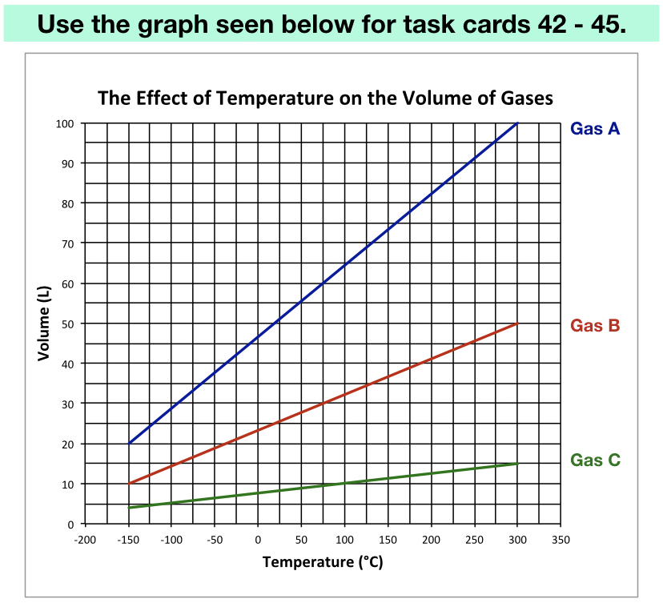
42
Scientific Method
At what temperature does Gas A have a volume of 50 L?
Answer:
Approximately 16 °C.

Slide 44
43
Scientific Method
At 50 °C, what is the volume of Gas B?
Answer: Approximately 28 L.

Slide 45
44
Scientific Method
Predict the volume of Gas C if the temperature is lowered to –200 °C.
Answer: Approximately 4 L.

Slide 46
45
Scientific Method
At what temperature will Gas B have a volume of 53 L?
Answer: Approximately 331 °C

Slide 47



Created by Amy Brown
Copyright © Amy Brown Science
All rights reserved by author.
This document is for your classroom use only.
This document may not be electronically distributed or posted to a web site.
Clipart Credit:

